Slide 1
IT5712 PROJECT I From Facts to Verdict: An AI-Powered Legal Judgment Prediction System for Indian Criminal Law
Presented By
Aashin A P (2022506072)
Pugazh U (2022506022)
Seshathri A (2022506102)
Somasundharam P (2022506310)
Under the Guidance of
Dr. M. Sumalatha, PROFESSOR,
Department of Information Technology, MIT

Slide 2
Base paper:
C. He, T.-P. Tan, X. Zhang and S. Xue, "Knowledge-Enriched Multi-Cross Attention Network for Legal Judgment Prediction," IEEE Access, vol. 11, pp. 89497–89512, Aug. 2023, doi: 10.1109/ACCESS.2023.3305259.
(https://ieeexplore.ieee.org/document/10216994)
Y. Le, Z. Quan, J. Wang, D. Cao, and K. Li, “R²: A Novel Recall & Ranking Framework for Legal Judgment Prediction,” IEEE/ACM Transactions on Audio, Speech, and Language Processing, vol. 32, pp. 1609–1622, 2024, doi: 10.1109/TASLP.2024.3365389.
(https://ieeexplore.ieee.org/document/10439618)
Keywords: Legal Judgment Prediction, Multi-Label Classification, Legal Knowledge Integration, Retrieval-Augmented Generation (RAG), Similar Case Matching, Attention Mechanism, Recall and Ranking (R²), Precedent-Based Reasoning, Explainable Legal AI, Structured Legal Knowledge, Court-Style Judgment Generation, NLP in Law.

Slide 3
Abstract
Many citizens in India lack awareness of their legal rights, applicable laws, and potential case outcomes, making legal processes intimidating and inaccessible.
Hybrid AI framework that predicts charges, IPC sections, and sentence durations from case facts using retrieval-augmented legal knowledge (RAG), attention-based precedent reasoning, and a two-stage recall-and-ranking mechanism.
By combining structured law, similar case analysis, and explainable judgment generation, the model empowers both legal professionals and the public with clearer, faster, and more transparent legal decision support under Indian criminal law.
Limitations
Existing models ignore similar past cases, leading to context-insensitive and inconsistent predictions.
Many models don’t use actual IPC definitions or structure — they learn patterns blindly from data, which can lead to legally invalid predictions.
The models function as black boxes, offering no reasoning, highlighted facts, or legal justification behind their decisions.

Slide 4
Objective:
Develop a multi-task AI model that predicts charges, IPC sections, and sentence durations from factual case descriptions using structured legal knowledge and language models.
Integrate legal reasoning through a 6-tuple knowledge base (definition, subjective/objective elements, legal context) and attention-based retrieval of similar Indian cases to enhance prediction accuracy and interpretability
Implement a two-stage recall-and-ranking mechanism to generate multiple legal outcome candidates and verify them using semantic consistency for confusion-prone cases.
Generate court-style judgment documents with explainable predictions, tailored for both legal professionals and general users in formats that include sections like “Facts”, “Analysis”, “Applicable Law”, and “Verdict”.

Slide 5
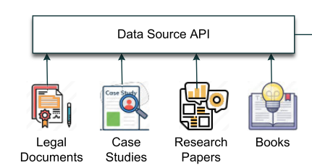
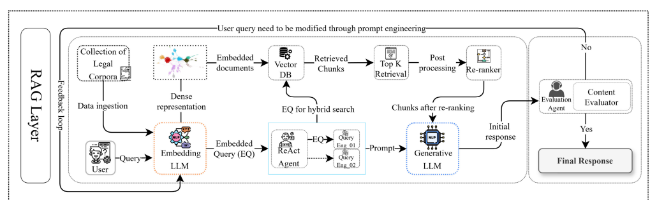
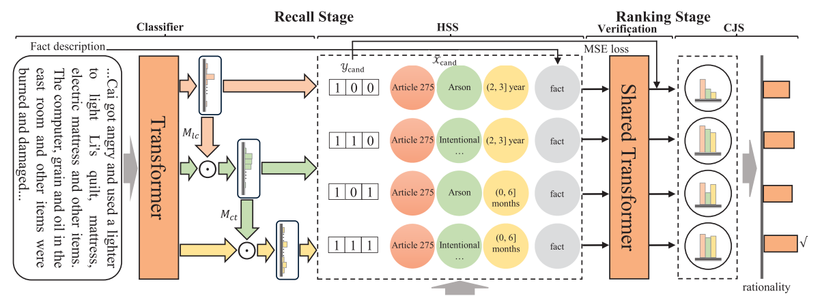
Proposed Workflow
User input(Case details)
KEMCAN LAYER
R2 Squared Layer
RAG Layer
Judgment Generation (User type aware Judgement document)

Slide 6
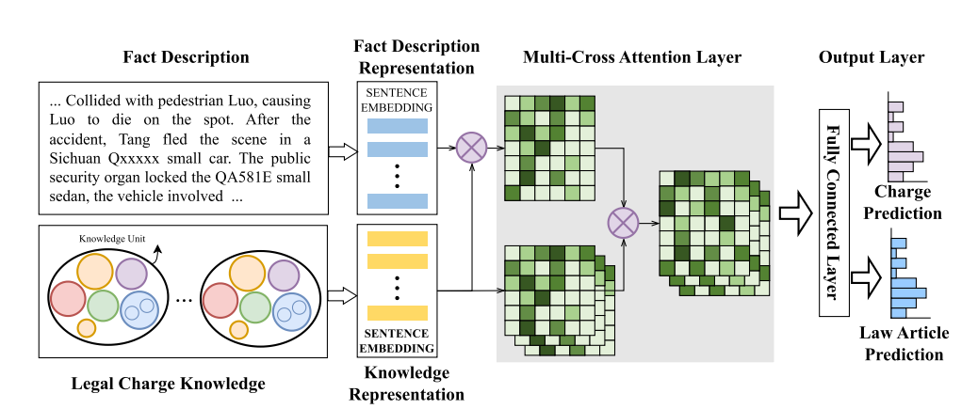
Knowledge-Enriched Multi-Cross Attention Network

Slide 7
References
[1] R. S. M. Wahidur, S. Kim, H. Choi, D. S. Bhatti, and H.-N. Lee, “Legal Query RAG,” IEEE Access, vol. 13, pp. 25574–25587, Mar. 2025, doi: 10.1109/ACCESS.2025.3542125.
[2] B. Wang, Y. Li, and C. Xu, “Exploring Bill Similarity with Attention Mechanism for Enhanced Legislative Prediction,” Journal of Social Computing, vol. 6, no. 2, pp. 112–125, Jun. 2025, doi: 10.23919/JSC.2025.0005.
[3] N. A. Samee, M. Alabdulhafith, S. M. A. H. Shah, and A. Rizwan, “JusticeAI: A Large Language Models Inspired Collaborative and Cross-Domain Multimodal System for Automatic Judicial Rulings in Smart Courts,” IEEE Access, vol. 12, pp. 112956–112972, Nov. 2024, doi: 10.1109/ACCESS.2024.3491775.
[4] A. Fan, S. Wang, and Y. Wang, “Legal Document Similarity Matching Based on Ensemble Learning,” IEEE Access, vol. 12, pp. 22574–22585, Mar. 2024, doi: 10.1109/ACCESS.2024.3371262.
[5] Y. Al-Shareef, “CHRExpert: An AI-Driven Court of Human Rights Expert Assistant for Legal Practitioners Utilizing Transformer Models,” IEEE Access, vol. 13, pp. 26740–26750, Mar. 2025, doi: 10.1109/ACCESS.2025.3547763.
[6] P. Bhattacharya, A. Ghosh, P. Sengupta, and S. Ghosh, “A dataset for statutory reasoning in Indian law,” in Proceedings of the 60th Annual Meeting of the Association for Computational Linguistics (Volume 1: Long Papers), Dublin, Ireland, May 2022, pp. 5562–5575, doi: 10.18653/v1/2022.acl-long.381.

